Slide 1

Sales Analysis
Feven Legesse Mammo

Slide 2
Today’s agenda
Project recap
Problem
Processes
Insights
Summary

Slide 3
Project Recap
AtliQ Hardware is a company that supplies computer hardware and peripheral manufacturing to many of its clients located in three regions ; North, South and Central.
We built a power BI dashboard to:-
1. Uncover sales order insights with latest data available.
2 . Support sales team to take better decisions and make 10% cost savings
of total spend.

Slide 4
PROBLEM
MARKET GAP
Not able to deliver for additional/new clients.
CUSTOMERS
Rise of customer complain.
FINANCIALS
Sales are declining from time to time.
COSTS
High cost for material distribution.

Slide 5
Process
1.
2.
3.
4.
5.
Data discovery and understanding
Data cleaning
Data Modeling
Data Analysis
Uncover insights

Slide 6
Insights
Late 2018 and onwards
₹984.87M
2M
Total revenue
Total Sales quantity
Sales are declinning

Slide 7
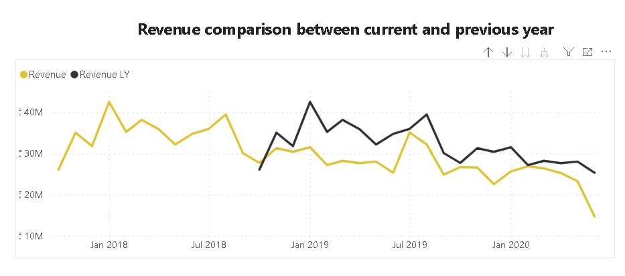
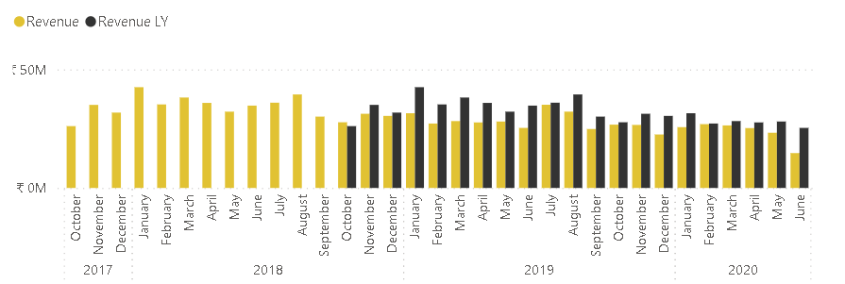

Slide 8
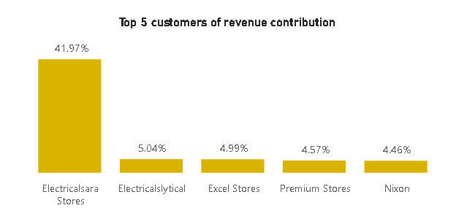
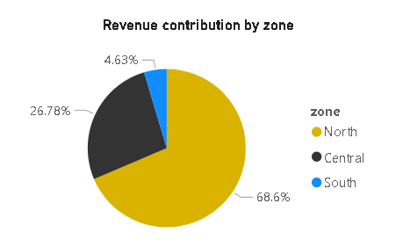
Revenue contribution
Feb 20XX

Slide 9
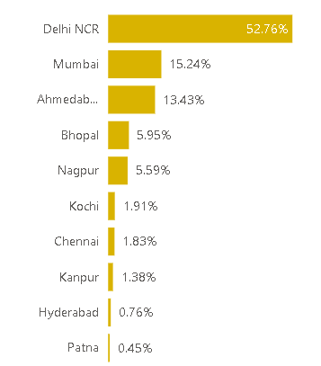
Top 10 market Revenue contribution

Slide 10
SUMMARY
Analysis: Even though sales shows fluctuations; are declining starting November 2018 and comparatively to previous year.
Insight: Northern region takes highest proportion in terms of revenue contribution fallowed by central region. In case of customers; Electrical sara store on top by approximately 42 % then other four followers which shows not a much of a difference between them, that means within the range of 5 % to 4.5%. Additionally, Delhi NCR, Mumbai and Ahmedabad are the three most significant revenue contributor markets and Delhi NCR covers around 53%.
Next step: This analysis is insightful, and we recommend to proceed with profit analysis so that to make more optimized business decision. Off course, we are here to help you in that case too.

Slide 11
THANK YOU Any question?

